Slide 1

Our digital journey
Adrian Hutchinson
Head of Department – English and maths

Slide 2
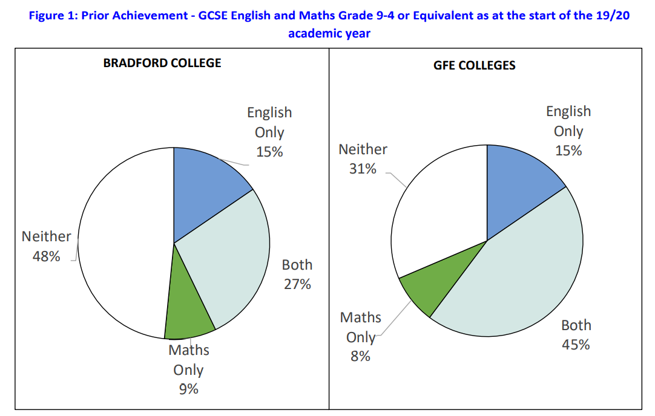
Context

Slide 3

Strategy

Slide 4
Lockdown engagement

Slide 5
Assessment Points
GCSE Assessment Points
Assessment Point | Dates | Marked by
DA1 | September 7-18 (CT) | Century Tech
AP1 | Autumn resits (November) | External
AP2 | w/c 21 January 2021 | Internal
AP3 | w/c 12 April 2021 | Internal
AP4 | Summer exams – May/June 2021 | External

Slide 6
How we drive engagement
Centralised text messaging
Centralised emails
Teams messages
Reminders from vocational tutors
Reminders from English and maths teachers
Competitions

Slide 7
Driving engagement

Slide 8
Driving engagement

Slide 9
Student Feedback
Century tech has been a means of revision for me over the past couple of months. It has helped me a lot in areas that I was struggling with, such as algebra and percentages. I have seen some improvements in those areas thanks to century tech nuggets.
I find it really useful. I can use it to revise things I have already covered but it also explains new topics. I think that at revision time it will be my most useful tool to cover everything again.
Hello, I try to use the century tec, a bit each week. I find this a very helpful way to learn. The nuggets are short, so they don`t get too boring. The videos are helpful and recap my English learning. I like that I can choose what I need to learn, or I can follow the recommend path.
I find it very useful for English. I have learnt a lot and it is now one of the main ways I study English so thank you.
I have been using century tech for my revision it has helped me and I’ve quickly got to know the topics of my weakest point to my strongest point.

Slide 10
Staff feedback
I think it is a good tool as in nuggets are tailored to student needs. It provides a single platform that students can use rather than google a topic for videos and worksheets, which can be overwhelming. They can login anytime and work on what they need to develop and make the most of their learning. It is also helpful for teachers to have a quick glance at engagement and progress made.
I have enjoyed using it, especially the planner to upload topics covered during session time for the students to work on independently but they will not be able to do this if they do not have access to technology. You can also see at a glance whether students have engaged with Century Tech or not which is also useful.
My adult students are engaging with it and finding it really helpful to underpin and consolidate what they’re doing in class. It’s then given them a real boost in confidence and helping them to develop their understanding and improve performance in class and homework. Some of my 16-18 year old students lack motivation, but those who have used Century Tech have said that it’s ‘sick’.

Slide 11
Contact
If you would like to have a follow up chat about our journey my email address is:
a.hutchinson@bradfordcollege.ac.uk
Or connect with me on LinkedIn

